Slide 1

ESi Artifact Tracking
David, Fletcher, Josh

Slide 2
Project Overview
Database contains all artifacts within the company and keeps track of where it was originally taken in from and where it is now.
Allows users to sign-in and sign-out artifacts.
QR Scanner allows users to scan qr codes to directly view artifact details.
Runs reports for artifacts that are overdue and need to be return to the origin location.

Slide 3
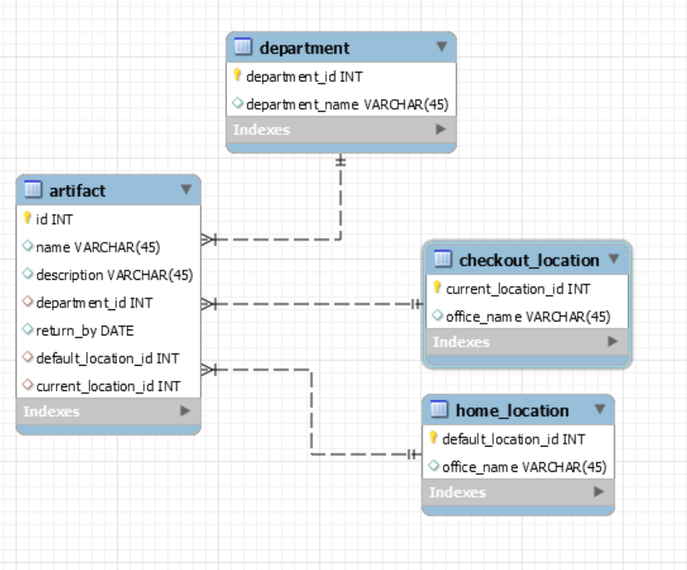
Database Structure

Slide 4
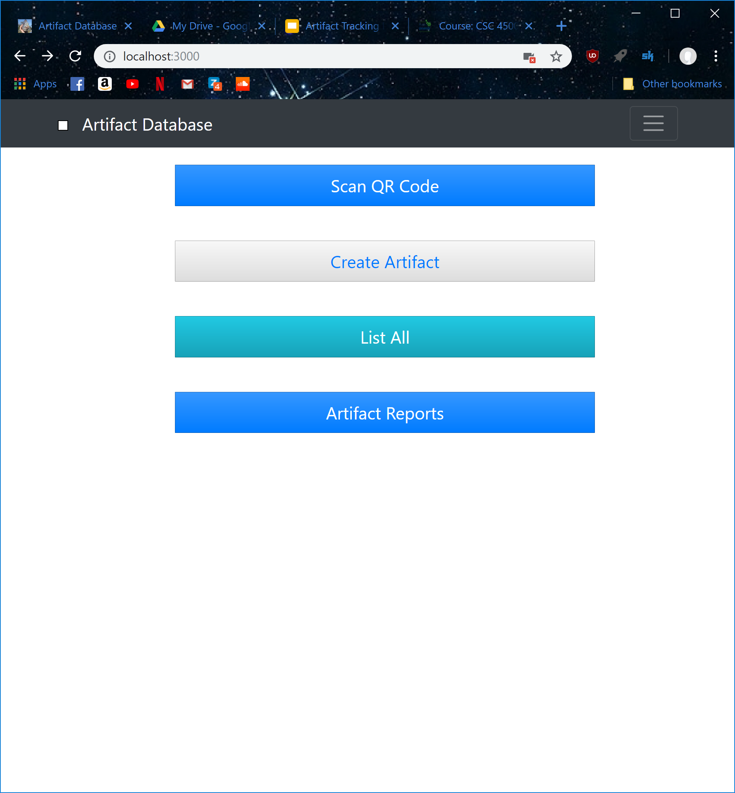
Landing Page

Slide 5
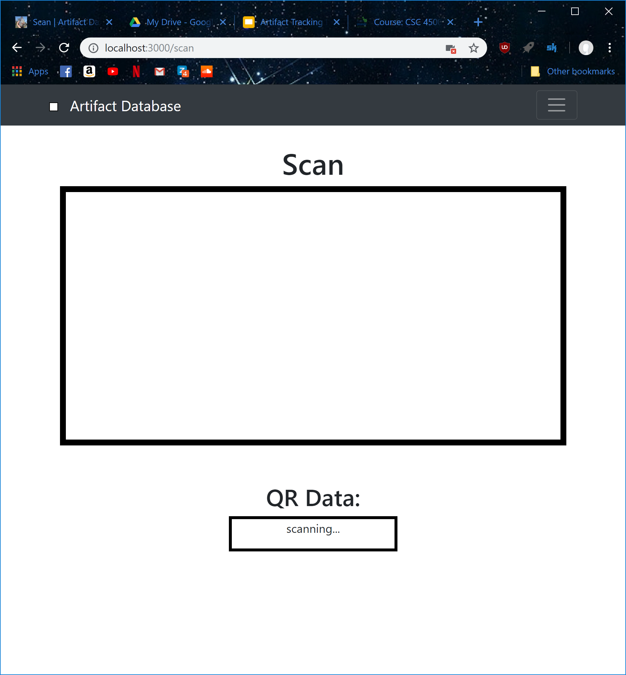
QR Scanner
Uses javascript library

Slide 6
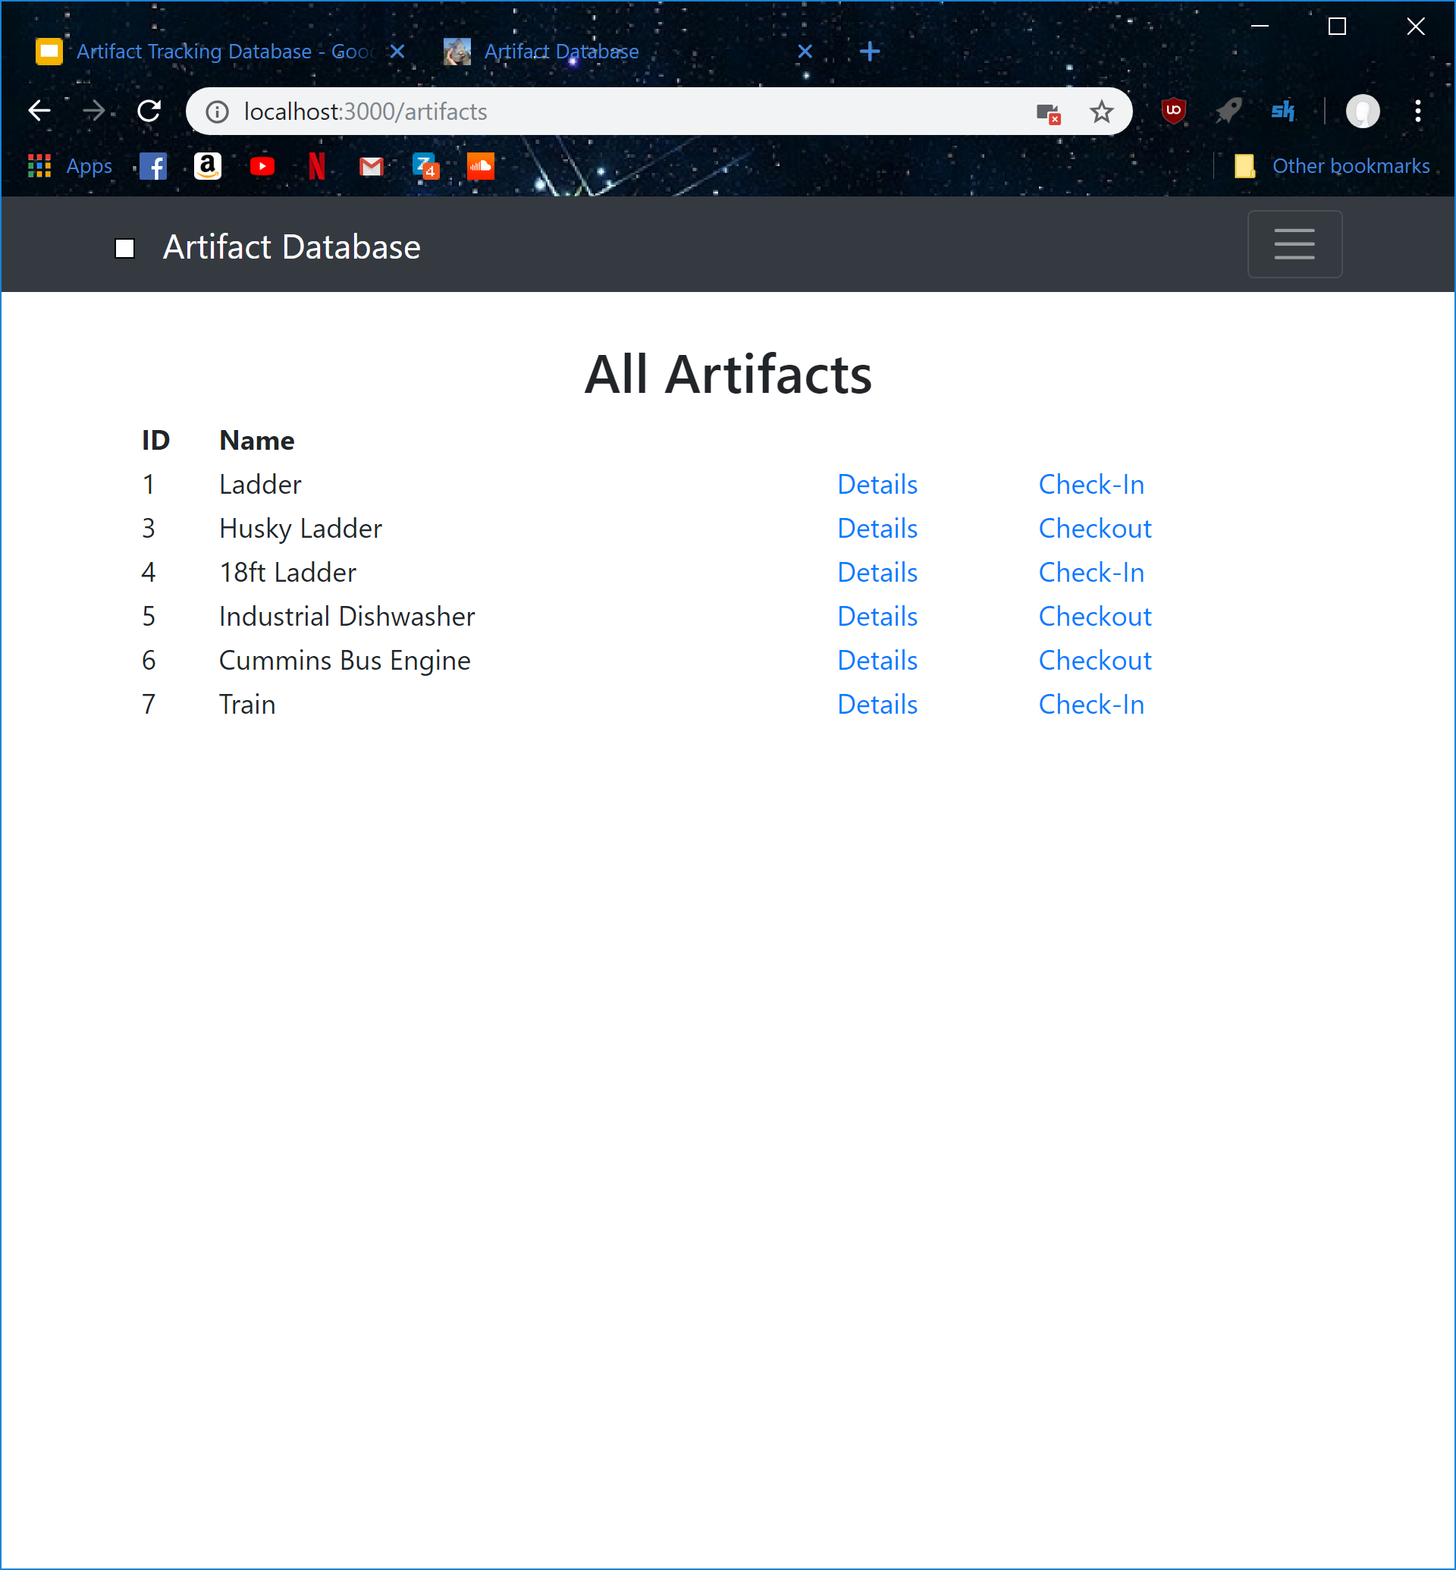
All Artifacts

Slide 7
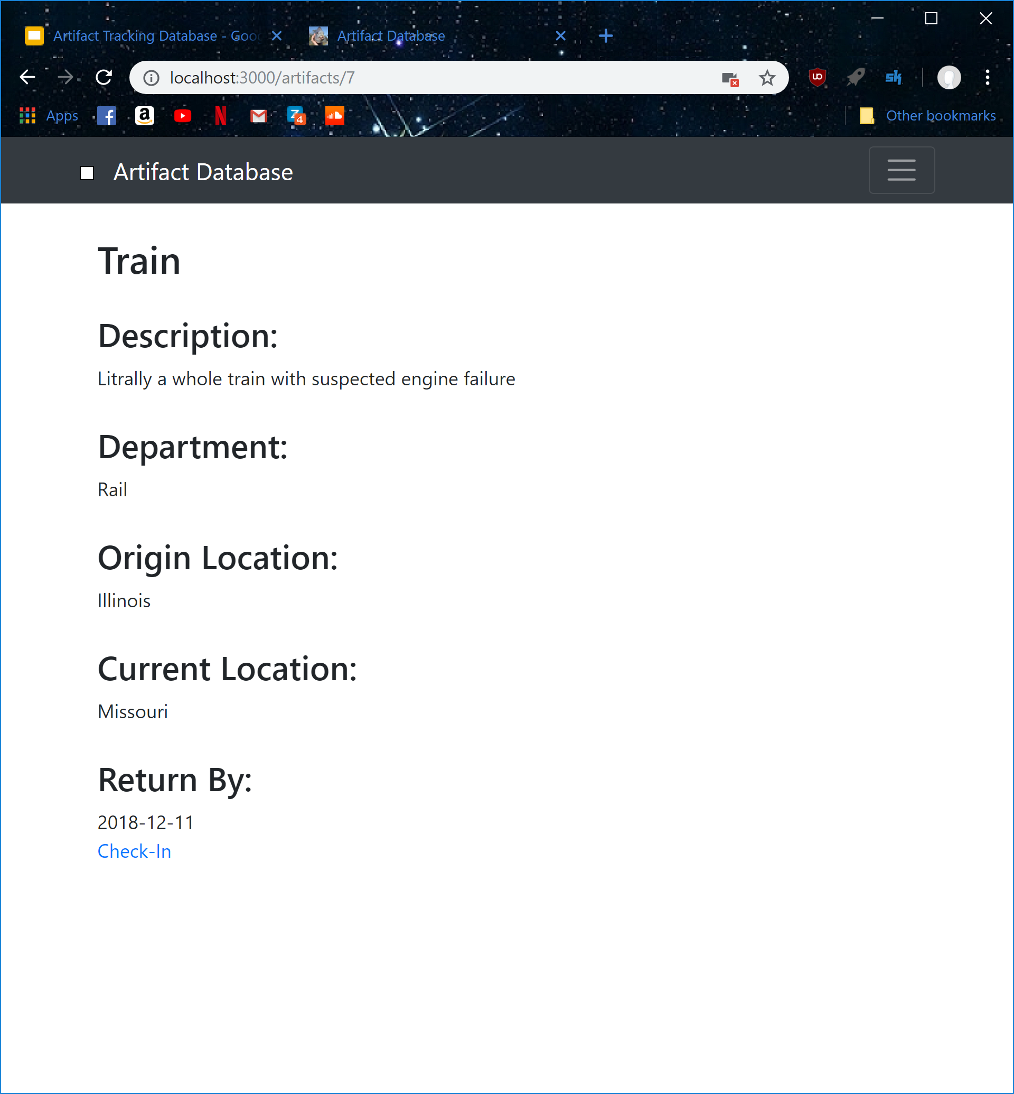
Details Page

Slide 8
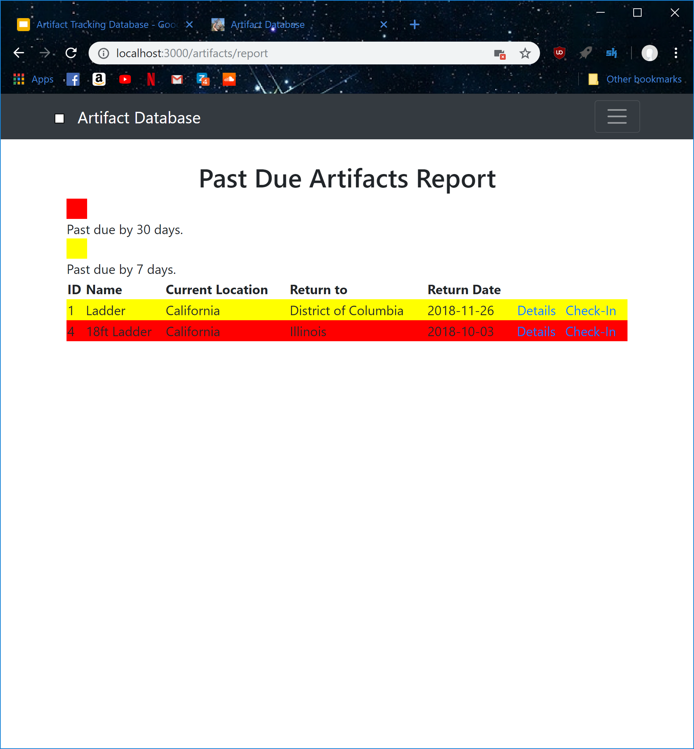
Reports

Slide 9
Demo

Slide 10
Roadblocks
QR Exception Handling
Embedded Ruby in Javascript
before_action
Triggers
Hairtrigger gem
Not really necessary in the scope of our project
Link_to
Check_in button was not going to the correct action

